Slide 1

Chapter 6
Pushdown Automata
In these slides, we will cover the following topics:
Basic structure of a pushdown automaton
Two types of acceptances by the pushdown automaton
Correspondence between context-free grammar and the pushdown automaton
Pushdown automaton as parser
Design of top-down and bottom-up parsers using the pushdown automaton

Slide 2
Basic Structure of Pushdown Automaton
Input Tape
Pushdown store →
Read head

Slide 3
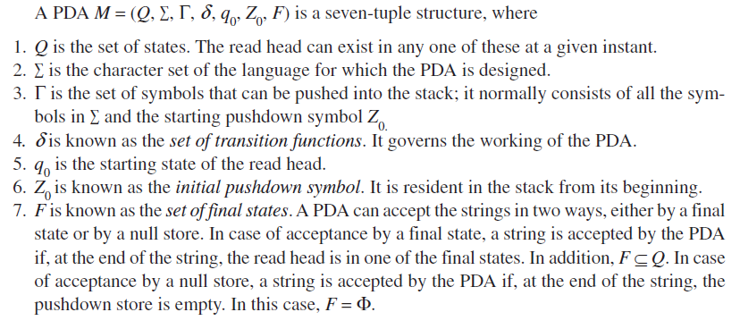
Description of PDA

Slide 4
Initial State of a PDA
( input string 00001111)
Input tape
0 0 0 0 1 1 1 1
Read
Head
(q₀)
Pushdown Store →
Z₀

Slide 5
Structure of Transition Function
δ(q_{i}, a, α) ├ (q_{j}, β)
Where
q_{i} current state
a symbol currently under read head
α symbol on the top of push down store
q_{j} new state after transition
β replacement for α on the top of push down store (It may even be null indicating that α is to be simply popped)

Slide 6
Two Types of Acceptance by PDA
Acceptance by null store
In the acceptance by null store, the pushdown store should be empty at the consumption of the input string. The input string w will be accepted by the PDA M by null store if
δ(q₀, w , Z0) ├* δ(q_{i}, ϵ, ϵ)
where q_{j} can be any state belonging to set of states Q.
Acceptance by final state
In the acceptance by final state, the PDA read head should be in the final state at the consumption of the input string.The input string w will be accepted by the PDA M by final state if
δ(q₀, w , Z0) ├* δ(q_{f}, ϵ, α)
where q_{f} is a final state belonging to set F

Slide 7
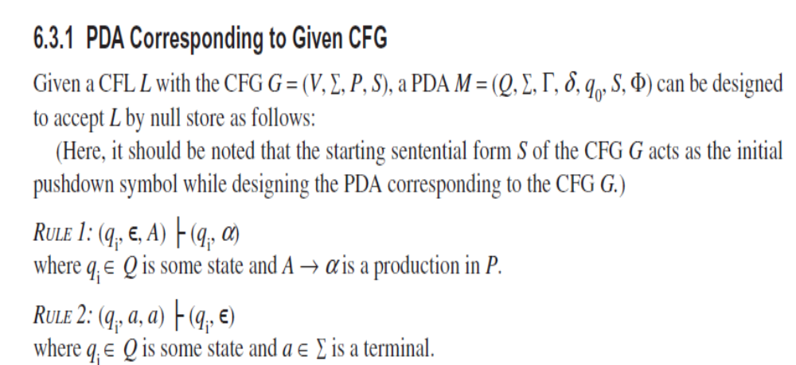
Correspondence Between PDA and CFL

Slide 8
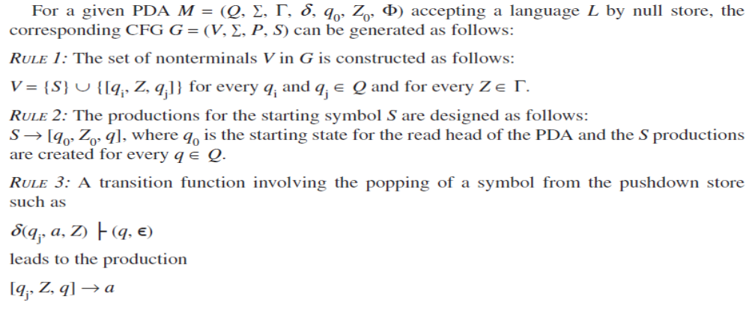
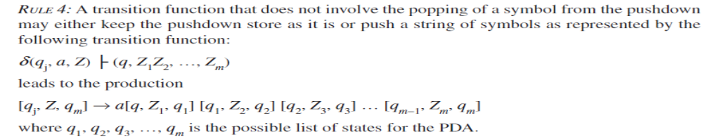
CFG Corresponding to PDA

Slide 9
Deterministic Pushdown Automata and Deterministic CFL
For a PDA to be deterministic it is necessary that for every a ∑, for every q belonging to Q and for every Y belonging to Г
δ(q_{i}, a, Y) has at the most one implication, and
If δ(q_{i}, a, Y) is nonempty, then δ(q_{i}, ϵ, Y) is empty
Language based upon Deterministic PDA is known as Deterministic CFL

Slide 10
Parsing and PDA
Given a sentence belonging to a language, the task of finding the derivation is known as parsing.
If a statement is not syntactically correct then it can not be parsed by the compiler and syntax error is declared by the compiler. The module in the compiler that performs the parsing task is known as parser.
PDA is a tool to implement CFG
If a word w belongs to a CFL L then it should be possible to derive w using the CFG G corresponding to L and show the acceptance of w by the PDA M which has been designed corresponding to G
To guide the PDA for parsing process it should by guided by a parsing table.

Slide 11
CFG and Parsing Table
CFG: S→ XS | YS| 2 X→ 0 Y→1
Let us assign numbers to productions
P1: S→ XS P2: S→YS P3: S→2
P4: X→ 0 P5: Y→1
Parsing Table
Input Symbol→ Current non terminal ↓ | ϵ | 0 | 1 | 2
S | Error | P1 | P2 | P3
X | Error | P4 | Error | Error
Y | Error | Error | P5 | Error

Slide 12
LL(k) Grammar
A grammar is said to be LL(k) grammar if k number of symbols required to be checked for selection of a production are k.
The grammar on the previous slide is a LL(1) grammar.
Given below is an example of LL(2) grammar.
S→X+X | X*X | X/X | X-X X→0
Operations used to convert LL(k) grammar to LL(k-1)
Removal of left factoring
Removal of left recursion

Slide 13
Removal of Left Factoring
Original CFG
P1:S→0X P2: S→0Y P3:X→0 P4:Y→1
After removal of left factoring
P1: S→0B P2: B→X P3: B→Y P4:X→0
P5: Y→1

Slide 14
Removal of Left Recursion
Original CFG with left recursion
X→Xα₁ | Xα₂ | Xα₃ |……..| Xα_{n} | β₁| β₂|……..| β_{k}
Equivalent grammar G’ without left recursion
X→ β₁X’| β₂X’|……..| β_{k}X’
X’→ α₁ X’|α₂X’|……..| α_{n} X’| ϵ

Slide 15
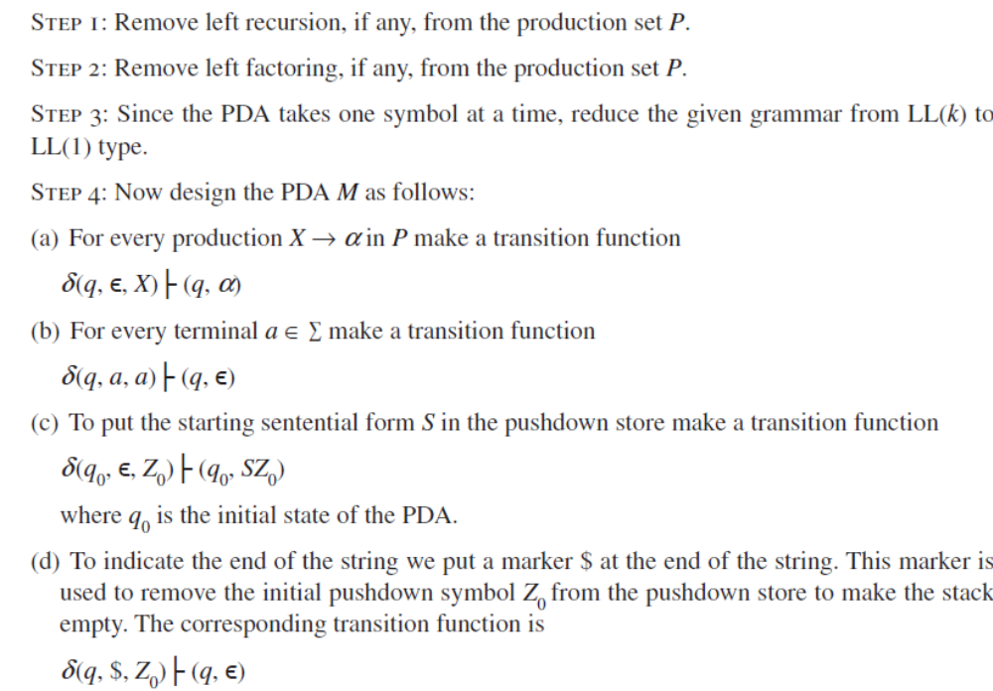
Top Down Parser

Slide 16
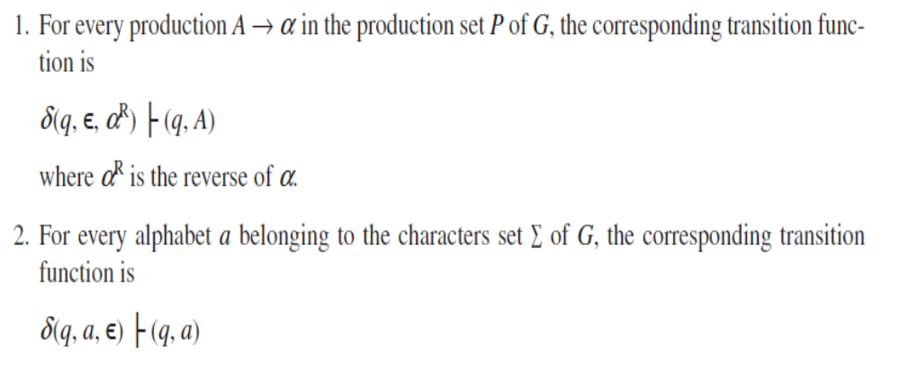
Bottom Up Parser

